Slide 1
Model Result of predicting customer buying behavior
By : raffel ravionaldo
November 2022

Slide 2
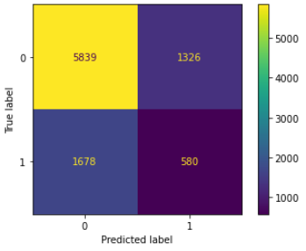

Result
Confusion Matrix of XGBoost Model
Our model is good for predicting customer purchases on weekdays, but not good for predicting purchases on weekends so we need more data on weekend purchases

